Slide 1
Inflation
U.S. inflation rate, 2000−2023¹
Many economists believe an inflation rate of around 2% is healthy
Many economists believe an inflation rate of around 2% is healthy
Inflation is when currency loses its spending power, usually because of a rise in the costs of goods and services over a period of time.
Although inflation can be alarming, it is part of a market cycle. Investments can be affected negatively or positively depending on their type. A well-rounded portfolio should include hedges against inflation. A financial advisor can help you determine which may be right for your time horizon, circumstances, and goals.
²
¹ “Inflation, Consumer Prices (Annual %) - United States.” World Bank Open Data. Accessed September 13, 2023. https://data.worldbank.org/indicator/FP.CPI.TOTL.ZG?locations=US&amp;name_desc=false.
² Consumer price index - August 2023 - U.S. Bureau of Labor Statistics, September 13, 2023. https://www.bls.gov/news.release/pdf/cpi.pdf.
Notes:
The word “inflation” often sparks fear, but it’s important to remember that it is part of the market cycle and there are ways to control it.
Inflation occurs when currency loses its spending value due to a rise in the costs of goods and services over a period of time.
As you can see in the chart, inflation rates fluctuate, but somewhere around 2% is believed to be healthy.
Governments also have strategies in place to help control inflation.
There are a variety of strategies to help your portfolio withstand inflation, and a financial advisor can help determine which may be right for you.

Slide 2
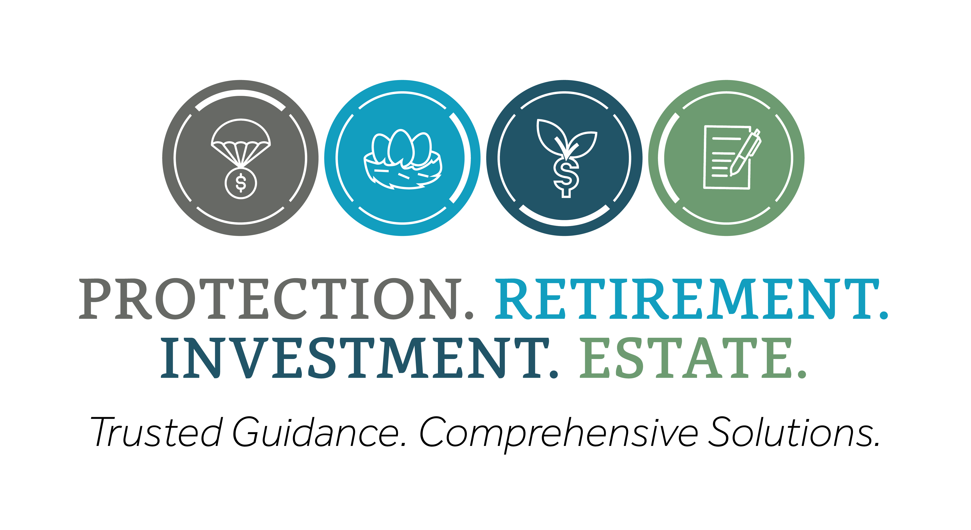
Eagle Strategies LLC (Eagle) is an SEC-registered investment adviser. Registration with the SEC does not imply a certain level of skill or training. Eagle investment adviser representatives (IARs) act solely in their capacity as insurance agents of New York Life, its affiliates, or other unaffiliated insurance carriers when recommending insurance products and as registered representatives when recommending securities through NYLIFE Securities LLC (member FINRA/SIPC), an affiliated registered broker-dealer and licensed insurance agency. Eagle Strategies LLC and NYLIFE Securities LLC are New York Life Companies. Investment products are not guaranteed and may lose value. No tax or legal advice is provided by Eagle, its IARs or its affiliates.
SMRU 5049340 (Exp. 2/28/2029)

